Slide 1

MARWA ISMAIL

Slide 2
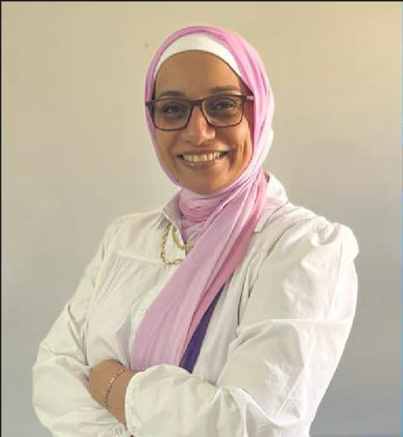
Wellcome
I’M Marwa
a dedicated content creator with a passion for crafting compelling stories and captivating visuals that drive engagement and build brand presence. I specialize in developing high-quality content across various platforms, including blogs, social media, websites, and multimedia. My goal is to produce content that resonates with audiences, enhances brand messaging, and achieves measurable results.

Slide 3

EDUCATION
COLLEGE
Faculty of information and technology
HIGHER EDUCATION
Digital Marketing Diploma in DEPI

Slide 4
SKILLS
Content Strategy
Developing and implementing content strategies that align with brand goals and audience needs.
SEO Optimization
Ensuring content is optimized for search engines to improve visibility and drive organic traffic.
Creative Writing:
Social Media Management
Crafting engaging and persuasive copy for various formats, including blogs, articles, and marketing materials.
Curating and scheduling content to build and maintain a strong social media presence.

Slide 5
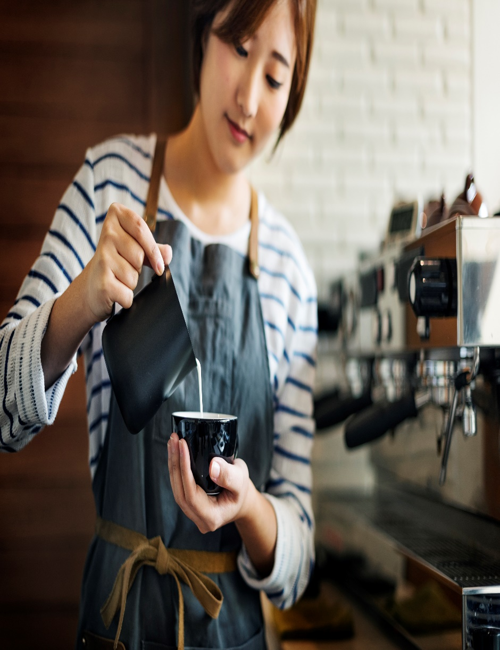

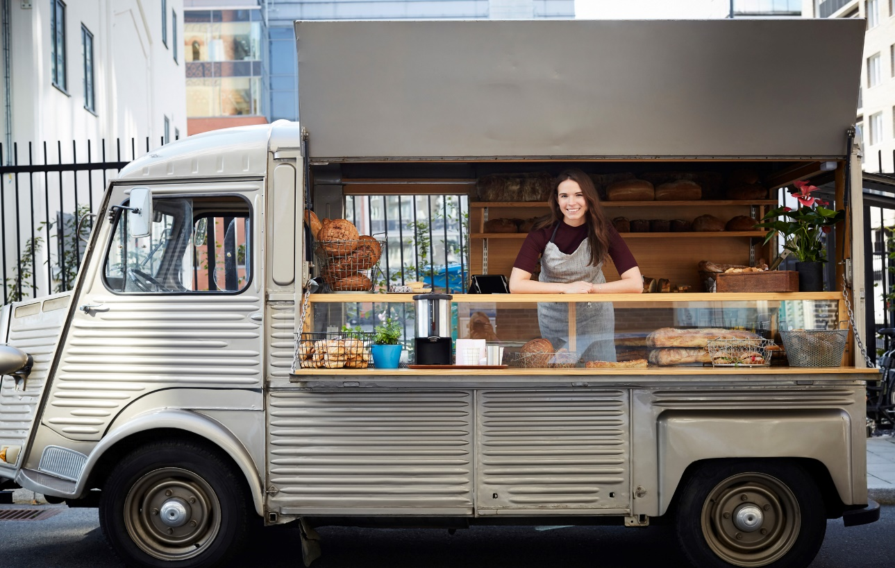
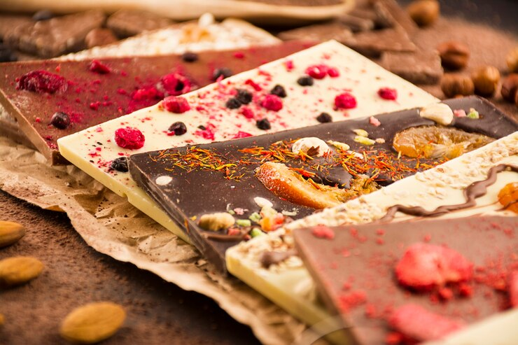

NOTABLE
PROJECTS
Earliest to current

Slide 6


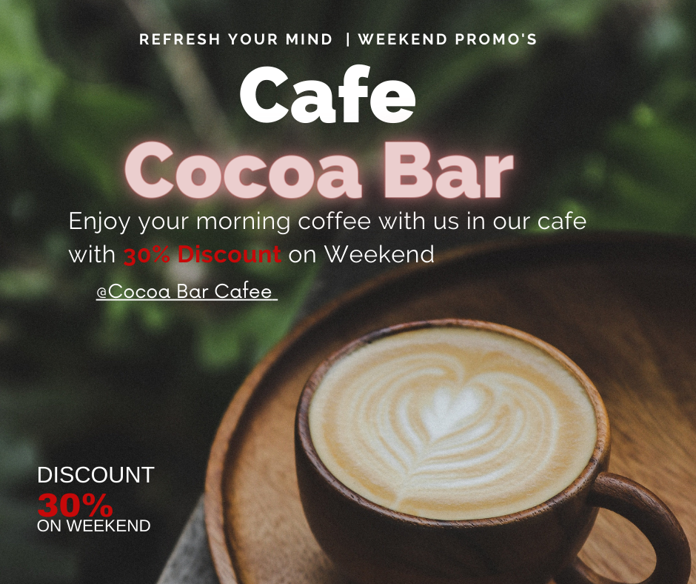

COCO-BAR CAFEE
The Coco-Bar Cafe project aimed to establish a unique and inviting coffeehouse experience in the heart of October City. The cafe blends a modern, cozy atmosphere with a diverse menu of artisanal coffee and chocolate with many different flavors . Our goal was to create a strong brand presence and attract a loyal customer base through strategic content creation and digital marketing efforts.
Key Achievements:
Increased Online Visibility. Enhanced Brand Image. Community Engagement.

Slide 7
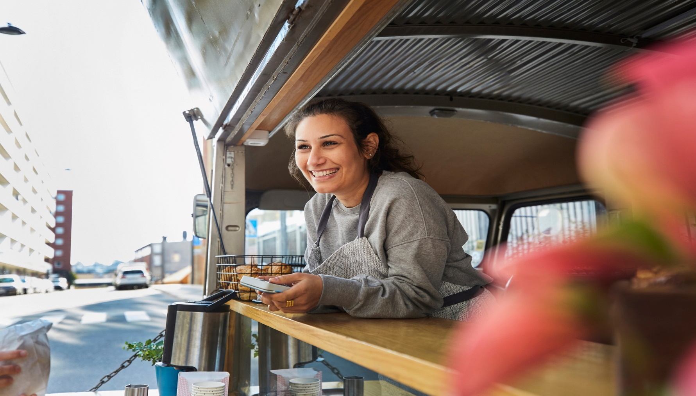
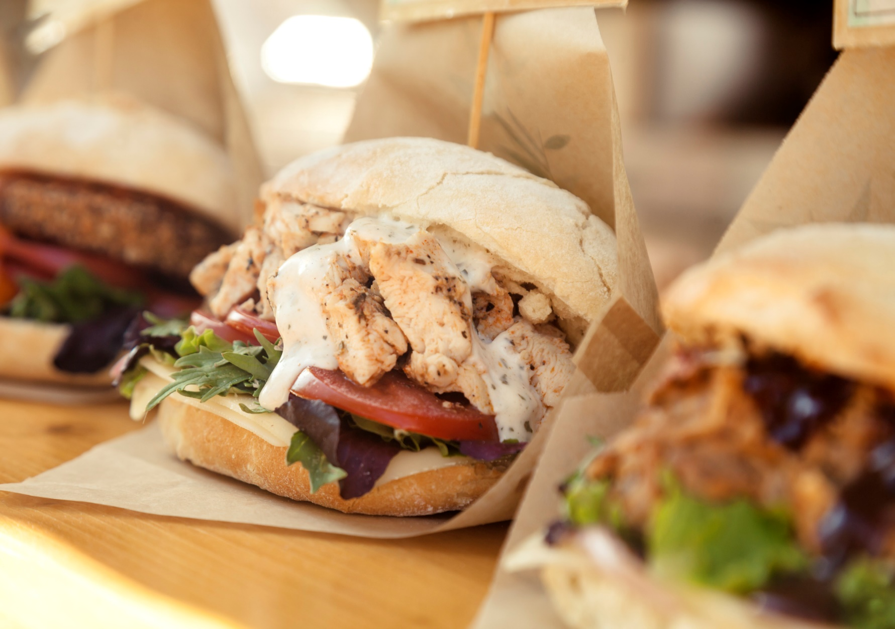
FOOD Truck
The اكله بيتي project aimed to launch and establish a dynamic and flavorful food truck business serving bank employees across EL Tagamo3 El 5ames. Our mission was to create a distinctive brand presence, engage food enthusiasts, and drive sales through targeted content creation and strategic digital marketing.
Key Achievements:
Enhanced Brand Visibility. Increased Engagement. Higher Conversion Rates.

Slide 8
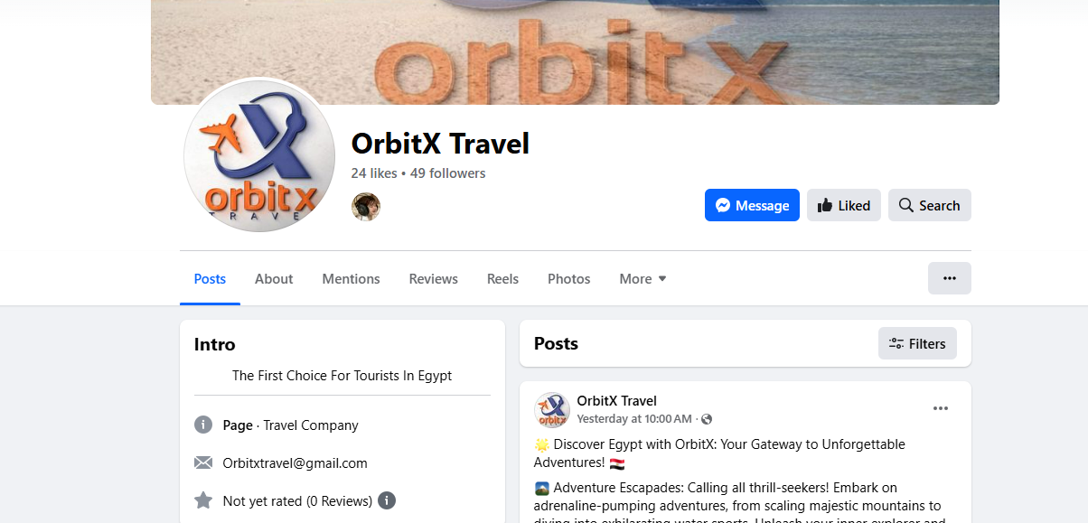
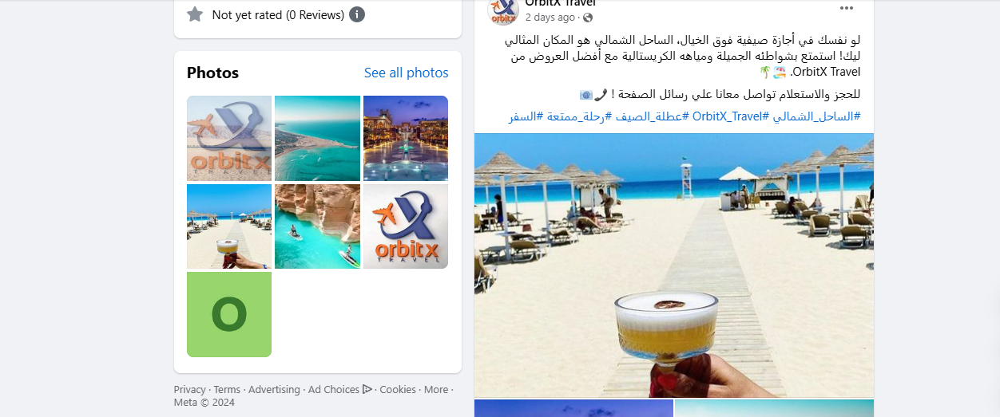
OrbitX travel Company
The OrbitX Travel Company project was designed to elevate the travel brand’s market presence and attract a diverse range of travelers seeking unique and memorable experiences. OrbitX aimed to position itself as a premier travel agency offering customized travel packages, expert advice, and exceptional customer service. The objective was to enhance the company’s digital footprint and drive bookings through targeted content and marketing strategies.
Key Achievements:
Enhanced Brand Visibility. Increased Engagement. Higher Conversion Rates.

Slide 9
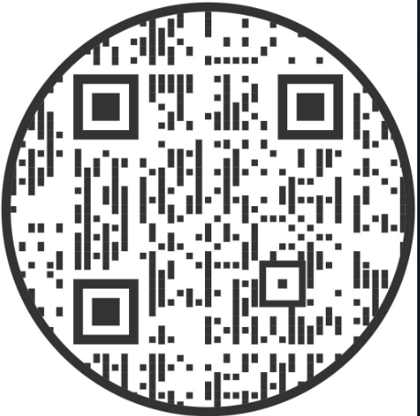
ElevteU Marketing Agency
ElevateU Marketing Agency is a dynamic, results-driven marketing firm that partners with businesses to elevate their brand presence, increase visibility, and drive measurable growth. We specialize in a wide range of digital marketing services, including search engine optimization (SEO), social media management, paid advertising, content creation, branding, and web design.
At ElevateU, we take a tailored approach to every campaign, understanding that each business is unique. Our team of experts works closely with clients to develop customized strategies that resonate with their target audience, maximize ROI, and foster long-term relationships.
Whether you're a startup looking to establish your digital footprint or an established brand aiming for the next level of success, ElevateU is your go-to partner for growth. We combine innovative tactics, data-driven insights, and creative solutions to elevate your business and achieve outstanding results.

Slide 10
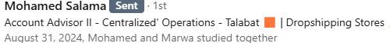
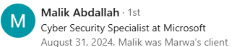

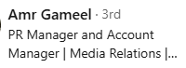
Testimonials:
I highly recommend Marwa Ismail as a digital marketer. Her innovative strategies and exceptional skills in digital campaigns have consistently delivered outstanding results. Marwa’s expertise in SEO, PPC, and social media, combined with her ability to stay ahead of trends, makes her a top performer in her field. She is a dedicated professional who adds immense value to any team.
It is with great enthusiasm that I recommend Marwa Ismail as a digital marketing agent. Marwa consistently demonstrates a deep understanding of digital marketing strategies and has an exceptional ability to execute campaigns that drive results. Her creativity, combined with her analytical skills, allows her to develop innovative solutions that resonate with target audiences.
I highly recommend Marwa Ismail as a professional digital marketer. Her strategic approach to digital marketing, combined with her expertise in SEO, content creation, and social media management, sets her apart. Marwa consistently delivers impressive results, demonstrating a deep understanding of market trends and audience engagement. Her ability to analyze data and adapt strategies effectively makes her an invaluable asset to any team. I am confident that she will excel in any marketing endeavor.
Marwa Ismail is the best hardworking woman i have ever met. She solves all my problems quickly and easily

Slide 11
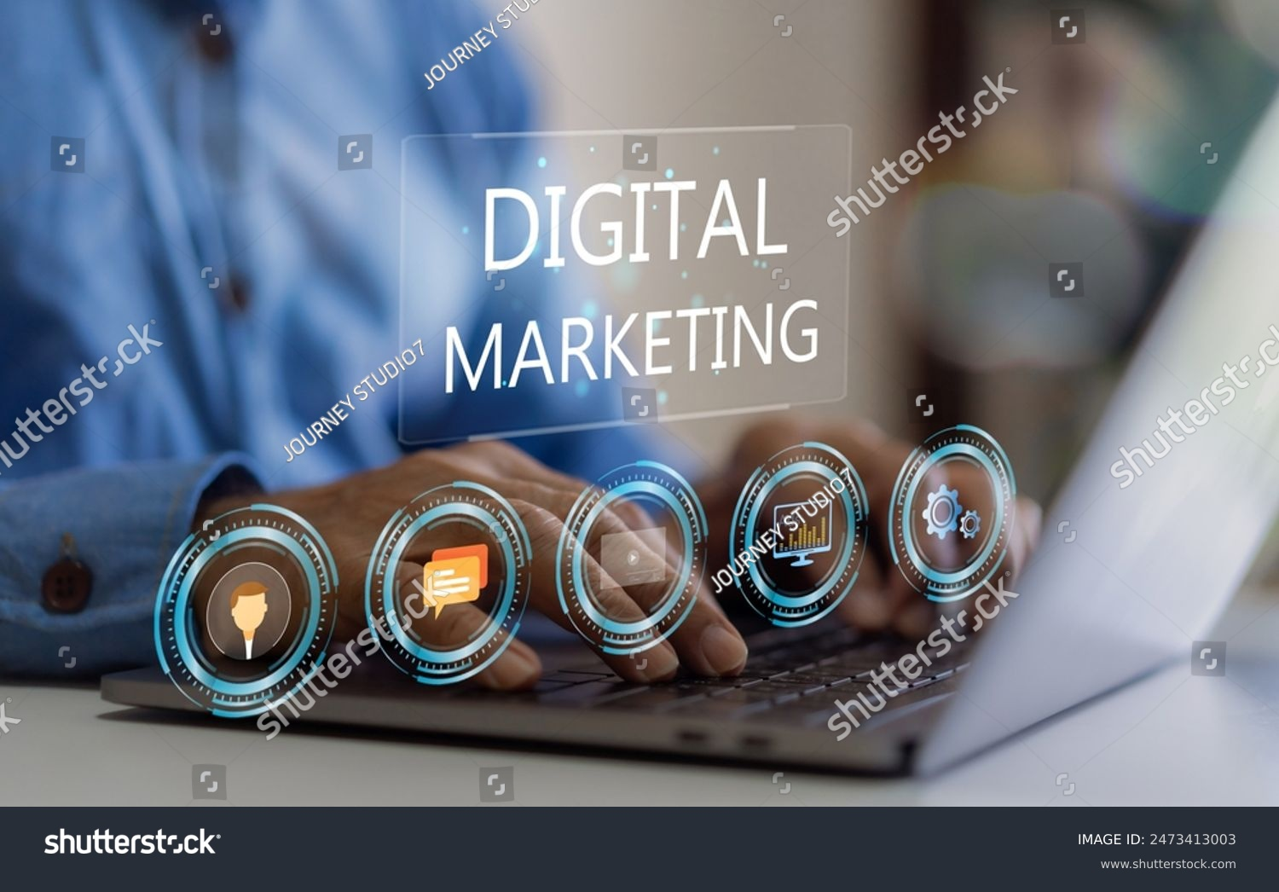

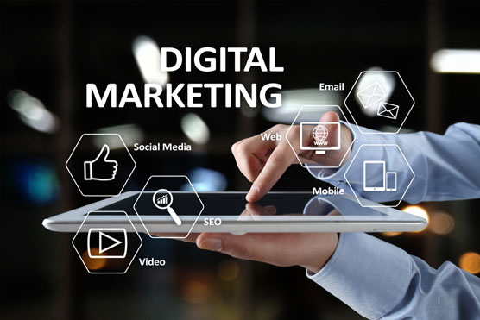
LET'S WORK
TOGETHER
Marwa81ismail@gmail.com 01118216216
(27) Marwa Ismail | LinkedIn

